Slide 1
SQL Server Basics for non-DBAs
Anil Desai

Slide 2






Speaker Information
Anil Desai
  Independent consultant (Austin, TX)
  Author of several SQL Server books
  Instructor, “Implementing and Managing SQL Server 2005” (Keystone Learning)
  Info: http://AnilDesai.net or Anil@AnilDesai.net

Slide 3
Overview and Agenda
SQL Server 2005 Platform Overview
Managing Databases
Database Maintenance and Data Protection
Securing SQL Server
Managing Database Objects / Best Practices

Slide 4
SQL Server 2005 Platform Overview
Understanding SQL Server’s features, services, and administrative tools

Slide 5
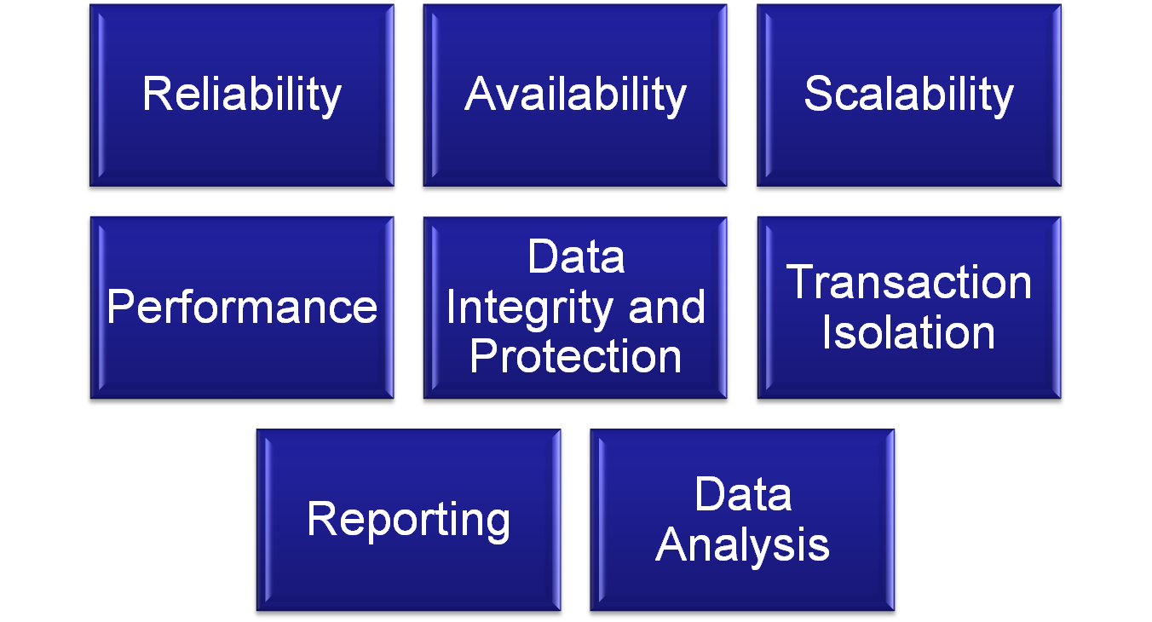
Relational Database Server Goals

Slide 6
SQL Server 2005 Architecture
SQL Server Database Engine
  Storage Engine
  Query Engine
Databases
  Logical collections of related objects
Instances
  Separate running services of SQL Server
    Default instance and named instances

Slide 7
SQL Server Services
Instance-Specific (one service per instance):
  SQL Server
  SQL Server Agent
  Analysis Services
  Reporting Services
  Full-Text Search
Instance-unaware
  Notification Services
  Integration Services
  SQL Server Browser
  SQL Server Active Directory Helper
  SQL Writer

Slide 8
SQL Server 2005 Admin. Tools
SQL Server Management Studio
  Database management GUI
    Object browser; templates, reports, etc.
  Based on Visual Studio 2005 IDE
  Support for writing and executing queries
SQL Business Intelligence Dev. Studio
  Analysis Services, Reporting Services, SSIS

Slide 9
SQL Server 2005 Admin. Tools
SQL Server Profiler
Database Engine Tuning Advisor
SQL Server Configuration Manager
  Manages services and protocols
Surface Area Configuration
SQL Server Books Online

Slide 10
Configuring SQL Server
Default options are set during installation
SQL Server Management Studio
Server Properties:
  Memory
  Processors
  Security (Windows, SQL Server); Auditing
  Database settings (default file locations)

Slide 11
Managing Databases
An overview of working with physical and logical database files

Slide 12
SQL Server Physical Data Files
Database storage
  Primarily table data and index data
Database Files:
  Primary data file (*.mdf)
  Secondary data files (*.ndf)
  Transaction log file(s) (*.ldf)
Filegroups:
  Logical collections of files
  Objects can be created on filegroups

Slide 13
Monitoring Disk Usage
SQL Server Management Studio Reports
  Server: Server Dashboard
  Database: Disk Usage (several reports)
Transact-SQL
  Stored Procedures:
    sp_Help, sp_HelpDB, sp_SpaceUsed
  System Tables / Views
    Sys.Database_Files

Slide 14
Designing Data Storage
Goals:
  Maximize performance by reducing contention
  Simplify administration
Best practices:
  Monitor and analyze real-world workloads
  Separate data files and transaction log files

Slide 15
Comparing RAID Levels
RAID Level | RAID Description | Disk Space Cost | Read Performance | Write Performance
RAID 1 | Disk Mirroring | 50% of total disk space | No change | No change
RAID 5 | Stripe Set with Parity | Equivalent to the size of one disk in the array. | Increased | Decreased
RAID 0 + 1 or RAID 10 | Mirrored Stripe Sets | 50% of total disk space | Increased | No change

Slide 16
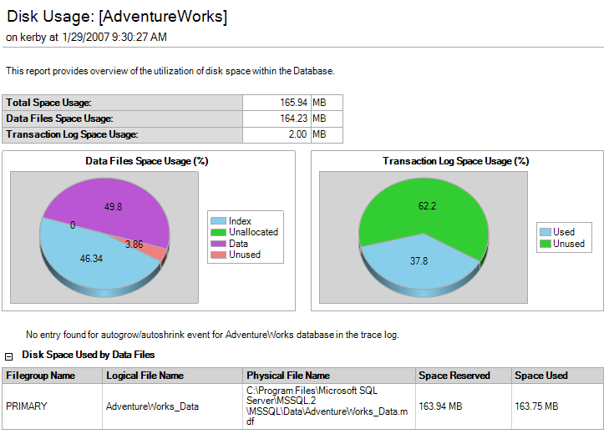
Monitoring Disk Usage

Slide 17
Moving and Copying Databases
Copy Database Wizard
Attaching and detaching databases
  Allows directly copying data/log files
  Database must be taken offline
Backup / Restore
Other methods:
  SQL Server Integration Services (SSIS)
  Generating scripts for database objects
  Bulk copy / BULK INSERT

Slide 18
Database Maintenance & Data Protection
Methods for maintaining, backing up, and restoring databases

Slide 19
Database Backup Types
Recovery Models
  Full
  Bulk-logged
  Simple
Backup operations
  Full Backups
  Differential Backups
  Transaction Log Backups
    Allows point-in-time recovery

Slide 20
Recovery Processes
Recovery process:
  Latest full backup (Required)
  Latest differential backup (Optional)
  Unbroken sequence of transaction log backups (Optional)
All transaction logs should be restored with NO RECOVERY option (except for the last one)
  Prevents database from being accessed while restore process is taking place

Slide 21
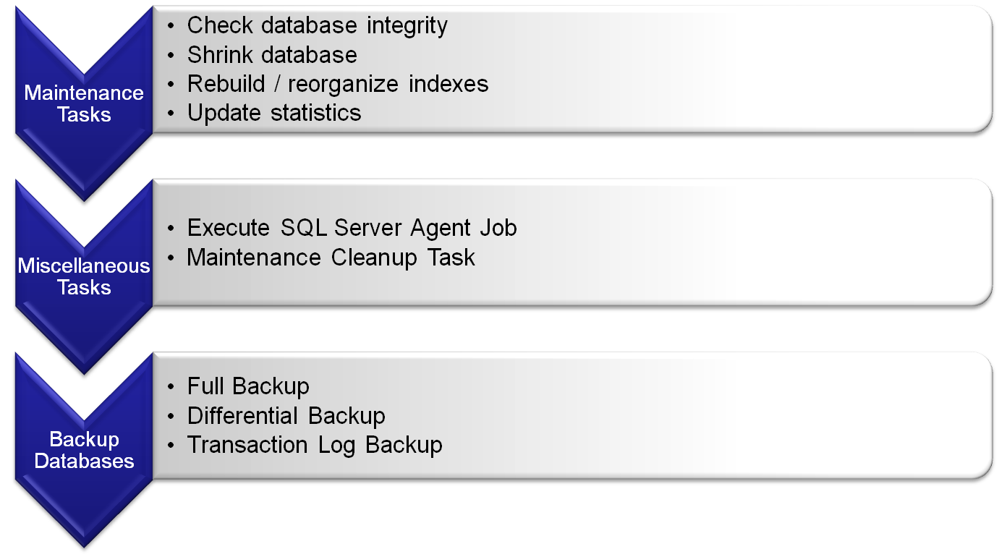
Database Maintenance Plans

Slide 22
Maintenance Plan Wizard
Scheduling
  Single schedule for all tasks
  Multiple schedules
Databases:
  System, All, All User, or specific databases
Wizard Options:
  Order of operations
Manages logging and history of operations

Slide 23
Reliability & Availability Options
Database Mirroring
Log-shipping
SQL Server Fail-Over Clusters
Distributed Federated Servers
Replication
Load-Balancing (at network or OS level)

Slide 24
Securing SQL Server
Understanding SQL Server 2005’s security architecture and objects

Slide 25
SQL Server Security Overview
Layered Security Model:
  Windows Level
  SQL Server Level
  Database
    Schemas (for database objects)
Terminology:
  Principals
  Securables
  Permissions
    Scopes and Inheritance

Slide 26
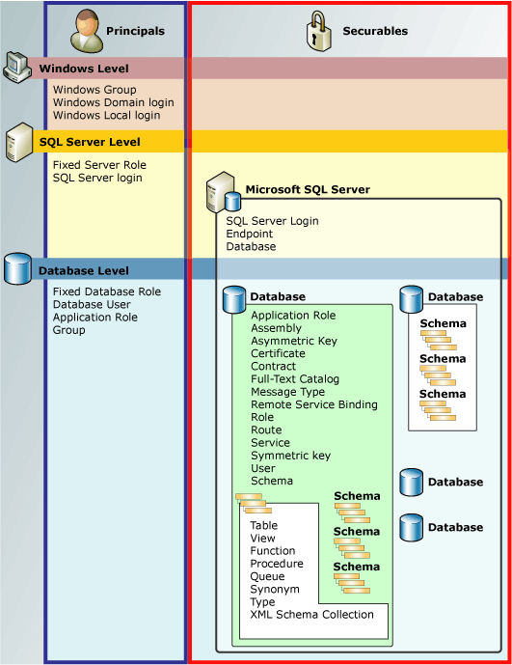
Security Overview
(from Microsoft SQL Server 2005 Books Online)

Slide 27
Security Best Practices
Make security a part of your standard process
Use the principle of least privilege
Implement defense-in-depth (layered security)
Enable only required services and features
Regularly review security settings
Educate users about the importance of security
Define security roles based on business rules

Slide 28
SQL Server Service Accounts
Local Service Account
  Permissions of “Users” group (limited)
  No network authentication
Network Service Account
  Permissions of Users group
  Network authentication with Computer account
Domain User Accounts
  Adds network access for cross-server functionality

Slide 29
SQL Server Surface Area Configuration
Default installation: Minimal services
SAC for Services and Connections
  Allow Remote Connections
  Access to Reporting Services, SSIS, etc.
SAC for Features
  Remote queries
  .NET CLR Integration
  Database Mail
  xp_cmdshell

Slide 30
Managing Logins
Windows Logins
  Authentication/Policy managed by Windows
SQL Server Logins
  Managed by SQL Server
    Based on Windows policies
  Password Policy Options:
    HASHED (pw is already hashed)
    MUST_CHANGE
    CHECK_EXPIRATION
    CHECK_POLICY

Slide 31
Creating Logins
Transact-SQL
  CREATE LOGIN statement
    Replaces sp_AddLogin and sp_GrantLogin
  SQL Server Logins
  Windows Logins
SQL Server Management Studio
  Setting server authentication options
  Login Auditing
  Managing Logins

Slide 32
Database Users and Roles
Database Users
  Logins map to database users
Database Roles
  Users can belong to multiple roles
  Guest (does not require a user account)
  dbo (Server sysadmin users)
Application Roles
  Used to support application code

Slide 33
Creating Database Users and Roles
CREATE USER
  Replaces sp_AddUser and sp_GrantDBAccess
  Can specify a default schema
  Managed with ALTER USER and DROP USER
CREATE ROLE
  Default owner is creator of the role
SQL Server Management Studio
  Working with Users and Roles

Slide 34
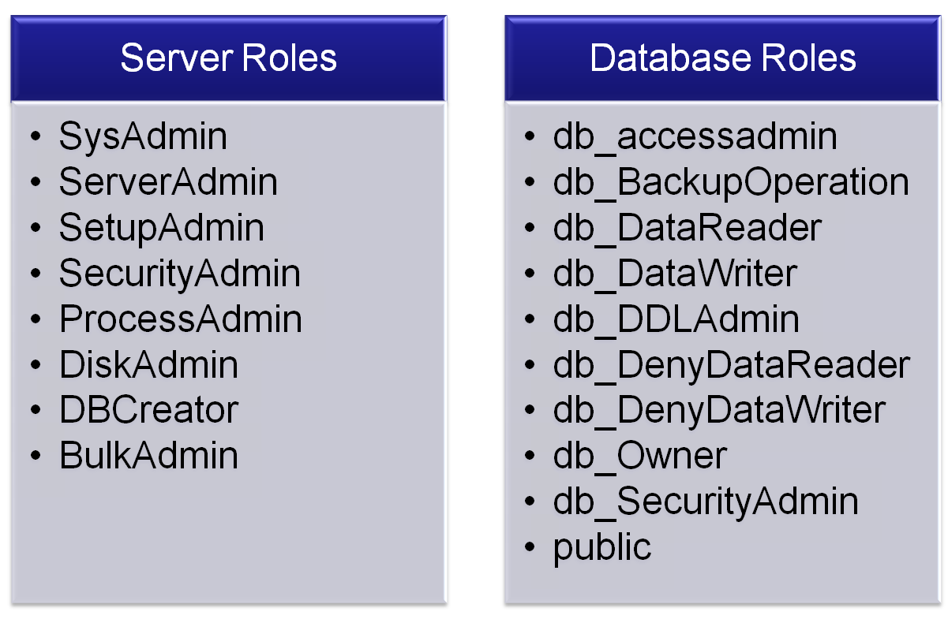
Built-In Server / Database Roles

Slide 35
Understanding Database Schemas
Schemas
  Logical collection of related database objects
  Part of full object name:
    Server.Database.Schema.Object
  Default schema is “dbo”
Managing Schemas
  CREATE, ALTER, DROP SCHEMA
  SQL Server Management Studio
  Can assign default schemes to database users:
    WITH DEFAULT_SCHEMA ‘SchemaName’

Slide 36
Configuring Permissions
Scopes of Securables
  Server
  Database
  Schema
  Objects
Permission Settings:
  GRANT
  REVOKE
  DENY
Options
  WITH GRANT OPTION
  AS (Sets permissions using another user or role)

Slide 37
Managing Execution Permissions
Transact-SQL Code can run under a specific execution context
  By default, will execute as the caller
EXECUTE AS clause:
  Defined when creating an object or procedure
  Options:
    CALLER (Default)
    SELF: Object creator
    Specified database username

Slide 38
Other Security Options
Database Encryption
  Encrypting Object Definitions
  Data encryption
SQL Server Agent
  Proxies based on subsystems allow lock-down by job step types
Preventing SQL Injection attacks
  Use application design best practices

Slide 39
Managing Database Objects
Understanding database design, tables, and indexes

Slide 40
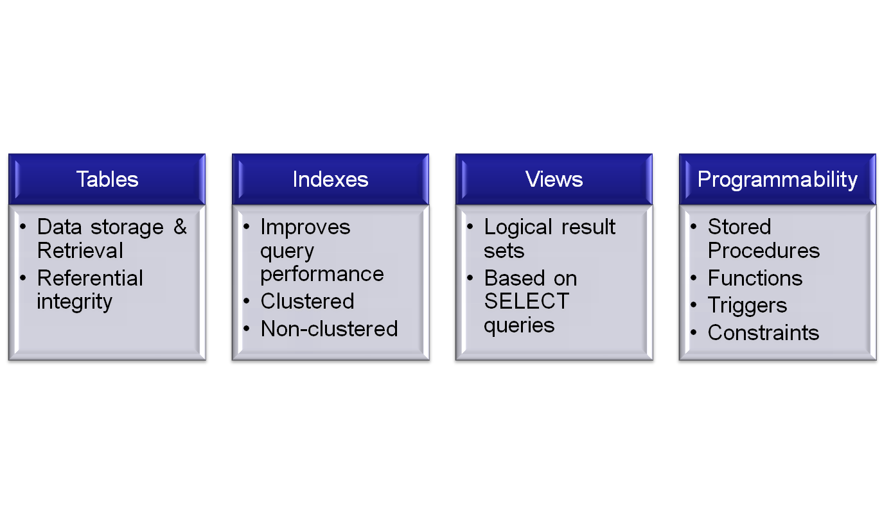
Overview of Database Objects

Slide 41
Designing a database
Normalization
  Reduces redundancy and improves data modification performance
  Denormalization is often done to enhance reporting performance (at the expense of disk space and redundancy)
Referential Integrity
  Maintains the logical relationships between database objects

Slide 42
The 1-Minute* SQL Overview
The Structured Query Language (SQL) defines a standard for interacting with relational databases
  Most platforms support ANSI-SQL 92
  Most platforms provide many non-ANSI-SQL additions
Most important data modification SQL statements:
  SELECT: Returning rows
  UPDATE: Modifying existing rows
  INSERT: Creating new rows
  DELETE: Removing existing rows
* Presenter makes no guarantee about the time spent on this slide

Slide 43
Indexing Overview
Index Considerations
  Can dramatically increase query performance
  Adds overhead for index maintenance
Best Practices
  Base design on real-world workloads
    SQL Profiler; Execution Plans
  Scenarios:
    Retrieving ranges of data
    Retrieving specific values

Slide 44
Index Types
Clustered index
  Controls the physical order of rows
  Does not require disk space
  One per table (may inc. multiple columns)
  Created by default on tables’ Primary Key column
Non-Clustered Index
  Physical data structures that facilitate data retrieval
  Can have many indexes
  Indexes may include many columns

Slide 45
Database Management
Best Practices
Maintenance and optimization of SQL Server 2005

Slide 46
SQL Server Maintenance
Monitor real-world (production) database usage
Communicate and coordinate with application developers and users
Develop policies and roles for database administration
Optimize database administration
  Automate common operations
  Generate scripts for routine maintenance

Slide 47
SQL Server Maintenance
Regular tasks
  Monitor disk space usage
  Monitor application performance
  Monitor physical and logical disk space
  Maintain indexes and data files
  Review backup and recovery operations
  Review security
  Review SQL Server Logs and/or Windows logs
  Verify the status of all jobs

Slide 48
SQL Server Management Features
SQL Server Agent
  Jobs
  Alerts
  Operators
SQL Server Logs
Database Mail
Linked Servers

Slide 49


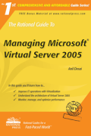
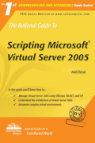
For More Information
www.microsoft.com/sql
Resources from Anil Desai
  Web Site (http://AnilDesai.net)
  E-Mail: Anil@AnilDesai.net
    Keystone Learning Course: “Microsoft SQL Server 2005: Implementation and Maintenance (Exam 70-431)”
    The Rational Guide to Managing Microsoft Virtual Server 2005
    The Rational Guide to Scripting Microsoft Virtual Server 2005

Slide 50
Questions & Discussion

